Slide 1

BRANCH
Vdd
Vdd_WRITE
Charge
CELL
Z
SL
Data0
WL
Data1
BL
…
Datax
Ref
Discharge
Select SL

Slide 2
BL0
SL0
BL1
SL1
BL2
SL2
BL3
SL3
WL0
WL1

Slide 3
BL0
SL0
BL1
SL1
BL2
SL2
BL3
SL3
WL0
WL1
Vdd
Vss

Slide 4
BL0
SL0
BL1
SL1
BL2
SL2
BL3
SL3
WL0
WL1
Vdd
Vss

Slide 5
BL0
SL0
BL1
SL1
BL2
SL2
BL3
SL3
WL0
WL1
Vss
Vdd

Slide 6
Local Block
…
LBenable
BL decoder
…
WL0
WL decoder
WL1
…
…
WL2
…
…
WLx-2
WLx-1
WLx
WLref
LBenable
…
BL passgates

Slide 7
VDD
VDD
ON
Z
BL
ON
~
BL
Rtot
R
SL
Req
OFF
ON
VSS
VSS

Slide 8
VDD
ON
ON
Z
Z
BL1
BL2
ON
ON
RH
RL
SL1
SL2
OFF
OFF
VSS
ON
ON

Slide 9
VDD
SL0
SL1
SLx
Z
Z
Z
BL0
BL1
BLx
…
…
…
…
LBout
VSS

Slide 10
Global Block
Local Block 0
Sample-and-Hold
LB_out
Sense Amplifier
Local Block 1
LB_out

Slide 11








WL decoder

Slide 13
Mtop
Mpassn
Mpassnbar
Mup
Mupbar
Mdown
Mdownbar
Mpassp
Mpasspbar
Mbottom

Slide 14
Vout
VDD
V+
+
Vout
V-
-
V - V
+
-
VDD
VSS
Vout
Voffset
Voffset
V+
-
+
+
V-
Vout
V - V
-
+
-
VSS

Slide 15
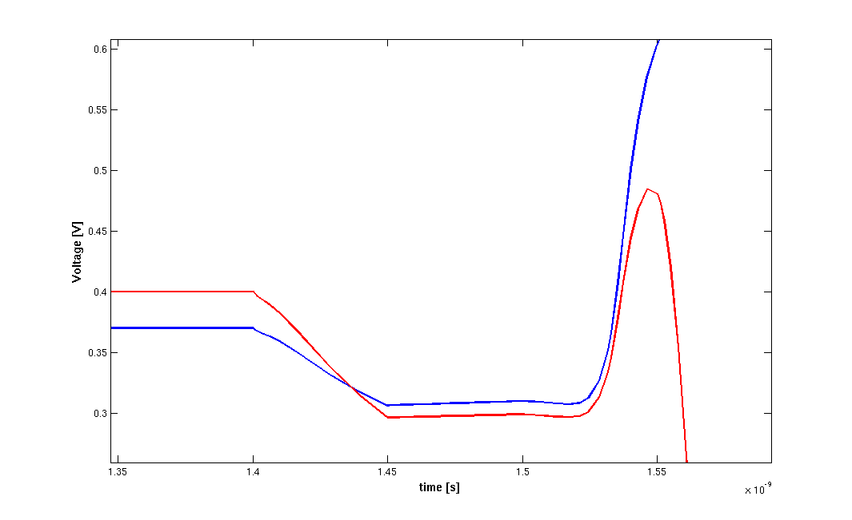
InOutbar
Pass gates turned off
No β variation
InOut
latching
nMOS β variation ( )

Slide 16
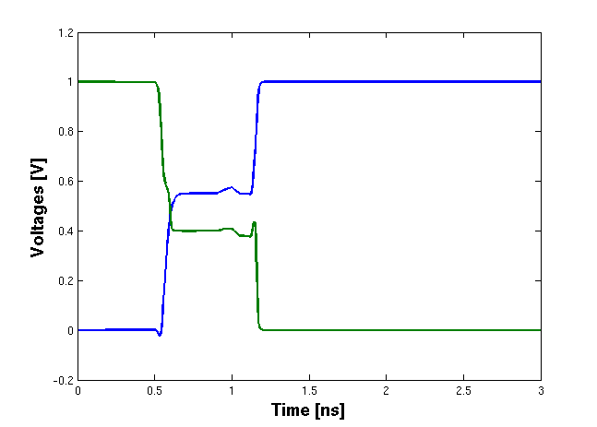
Passgates turned on
Passgates turned off
InOut
SA turned on
InOutbar

Slide 17
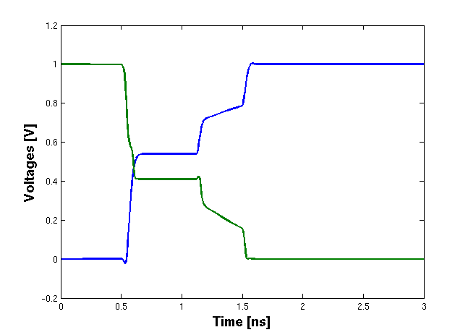
Passgates turned on
Passgates turned off
SA turned on
InOut
InOutbar

Slide 18
R
R
CL
Cint
Cint
CL

Slide 19
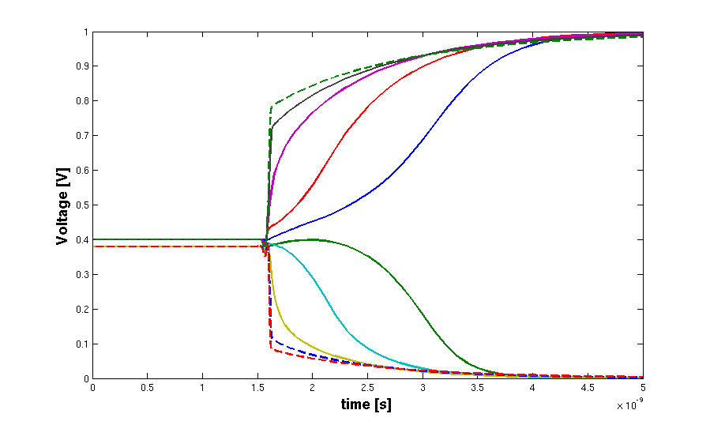
R=0 Ω
R=5 kΩ
R=10 kΩ
R=15 kΩ
R=20 kΩ

Slide 20
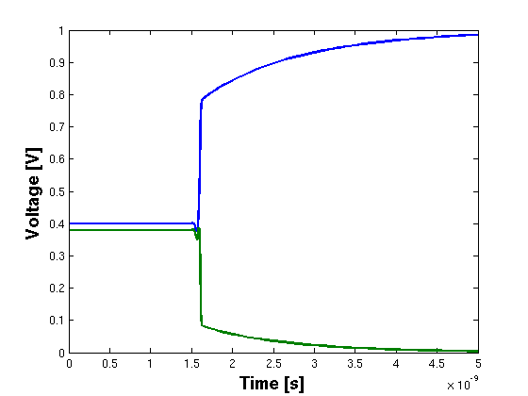
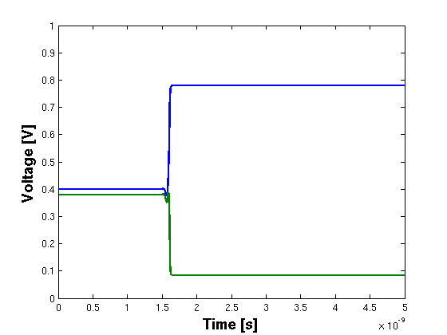
V(t=0)=0.4V
V(t=0)=0.38V
V(t=0)=0.4V
V(t=0)=0.38V
0.4V
+
+
0.38V
-
-

Slide 21
Vcap
V(t) = a t

Slide 22
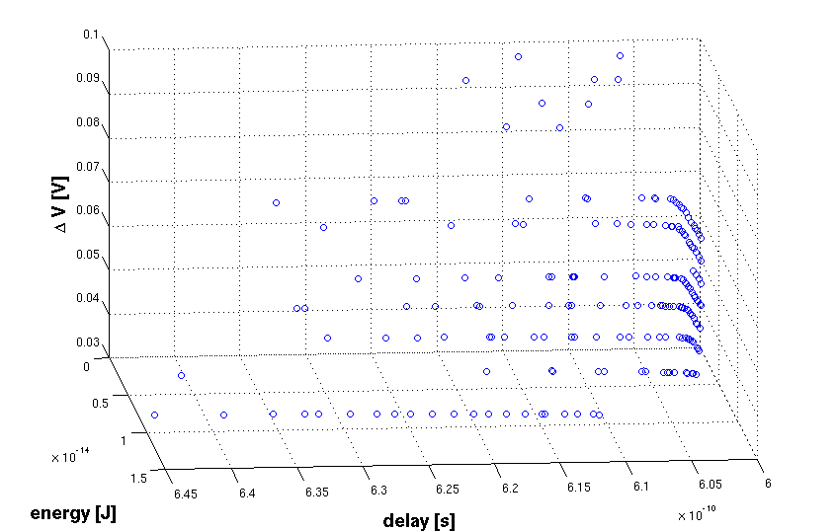

Slide 23
Vx
Vdd
Vs
+
Vdd
Vs
+
-
-
Vx

Slide 24
Vx
Vs
+
Vs
+
-
-
Vx

Slide 25
GB0_Enable
GB1_Enable
GB2_Enable
GBx_Enable
GB_0
GB_1
GB_2
…
GB_x
Encoded BL-driver

Slide 26
GB0_Enable
GB1_Enable
GB2_Enable
GBx_Enable
GB_0
GB_1
GB_2
…
GB_x
Encoded BL-driver

Slide 27
LB0en
GB0en
LB1en
GB01en
BL_Enc_xx
…
GB0xen

Slide 28
A
t
A
B
A+B
B
t
A+B
t

